Slide 1

5 THE NETWORK LAYER
5.1 NETWORK LAYER DESIGN ISSUES
5.2 ROUTING ALGORITHMS
5.4 INTERNETWORKING
5.5 THE NETWORK LAYER IN THE INTERNET
Stainov - DataCom
MET CS TC535

Slide 2
5 THE NETWORK LAYER
5.1 NETWORK LAYER DESIGN ISSUES
Importance: It represents the boundary to the subnet (i.e. to the network carrier) → it must be especially well defined.
Main goals:
  The services should be independent of the subnet
  The transport layer should be shielded from the number, type, and topology of the subnet
  The network addresses should be uniform.
Two camps:
Internet community - the subnet should move independent datagrams and nothing else (no flow control, packet ordering and error control).
Telephone companies - the subnet should provide reliable connection-oriented service, with QoS (Quality of Service) negotiation, packet ordering, and flow control.
Stainov - DataCom
MET CS TC535

Slide 3
THE NETWORK LAYER
5.1 NETWORK LAYER DESIGN ISSUES - Internal Organization
Virtual circuits (VC) - connection setup (choosing of the route to the destination), forwarding packets over the exactly that route (the router maintains a table with the unique virtual circuit # ), and connection release (termination of the VC).
Datagrams - no routers are working in advance, even if the service is connection oriented. Each packet is sent independently from the previous ones and routed over a different route. The routers do not maintain virtual circuit #s. Each packet is carrying the full destination address. Establishment of connections is done by the end stations, and does not require any special work from the routers.
Stainov - DataCom
MET CS TC535

Slide 4
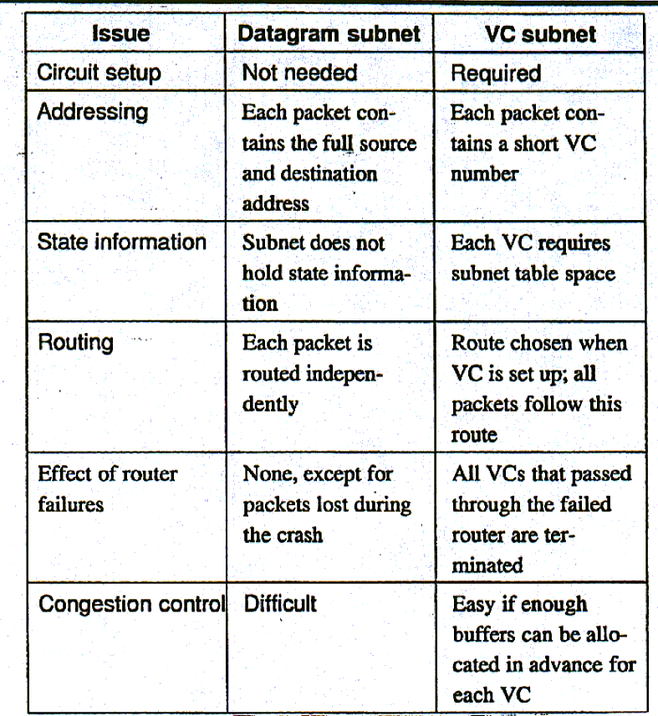
THE NETWORK LAYER
  Comparison of VC
  and Datagram Subnets
Stainov - DataCom
MET CS TC535

Slide 5
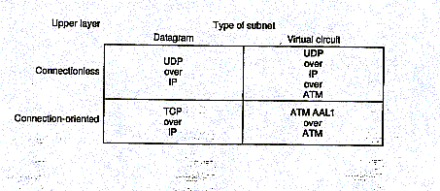
THE NETWORK LAYER
Comparison of VC and Datagram Subnets
All variations of connectionless, or connection-oriented, over VC, or over datagrams, are possible - for example IP (connectionless) over ATM (VC) subnet.
Stainov - DataCom
MET CS TC535

Slide 6
THE NETWORK LAYER
5.2 ROUTING ALGORITHMS
Common Requirements:
Correctness - no deadlocks, livelocks, unreachable states
Simplicity - fast handling of packets, less failures
Robustness - dealing with failures, changes of the topology and of the traffic.
Stability - the algorithm should congregate to equilibrium
Fairness - no starvation, load balancing
Optimality - short packet delay, max. throughput, number of hops
1. Nonadaptive algorithms - do not base the routing decisions on measurements. The routing is in most cases static (computed in advance), off-line and downloaded to the routers.
2. Adaptive algorithms - change their routing algorithms (continuous, periodic, occasionally) to reflect changes in the topology, and some times in the traffic. The information source can be local, nodes along the route, or all nodes.
Stainov - DataCom
MET CS TC535

Slide 7
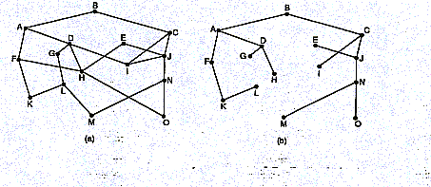
THE NETWORK LAYER
5.2 ROUTING ALGORITHMS
The set of optimal routes from all sources to a given destination forms a sink tree.
The goal of the routing algorithms is to discover the sink trees for all routers.
Stainov - DataCom
MET CS TC535

Slide 8
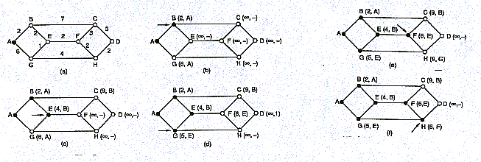
THE NETWORK LAYER
5.2 ROUTING ALGORITHMS - Static
Shortest Path Routing - A frequently used metric is the number of hops. Each router examines each of the nodes adjacent to it, calculates the new distance sum, and if it is less than the label on that node, we have the shortest path, so the node is relabeled.
Stainov - DataCom
MET CS TC535

Slide 9
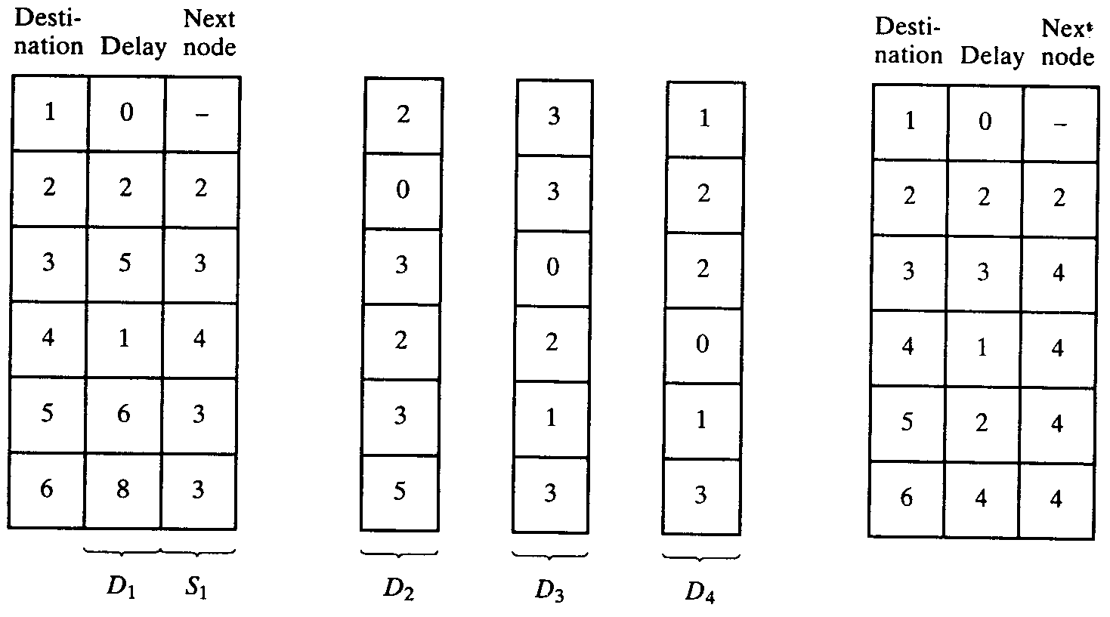
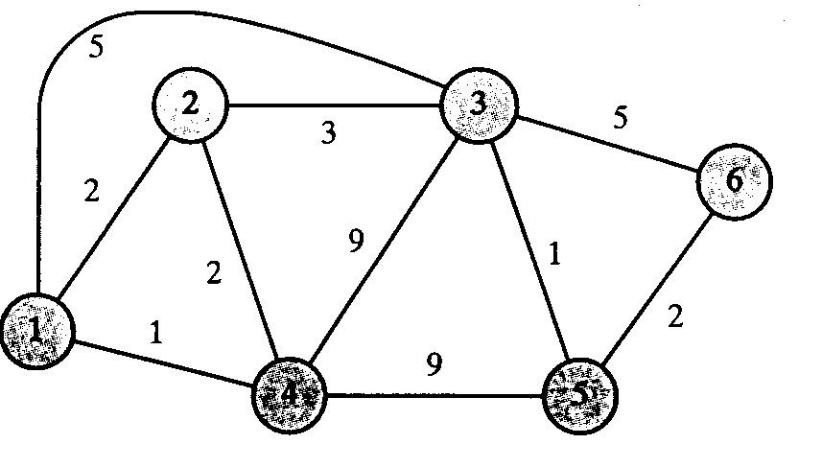
THE NETWORK LAYER
5.2 ROUTING ALGORITHMS - adaptive
Distance Vector Routing (Bellman-Ford, Ford-Fulkenson). It was used in early versions of ARPANET and in Internet (RIP), DECnet,, AppleTalk and Cisco.
Each router maintains a table (i.e. a vector) indexed by, and containing one entry for each router in the subnet. The entry contains the preferred outgoing line for this destination and an estimate giving the best known distance to that destination (# of hops, time delay, etc.).
Once every T msec each router sends to (and receives from) each neighbor a list of estimated distance to each destination. The router recalculates the distances.
Stainov - DataCom
MET CS TC535

Slide 10
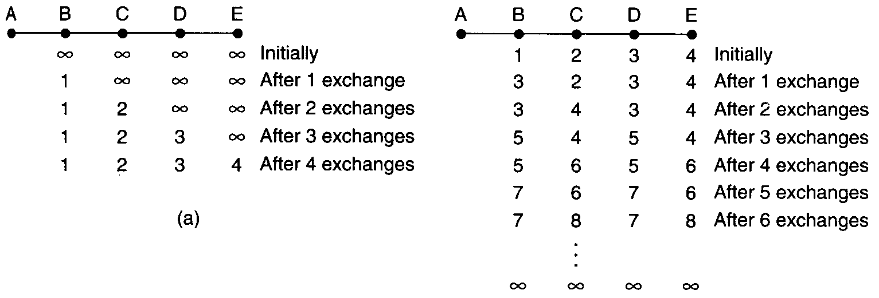
THE NETWORK LAYER
5.2 ROUTING ALGORITHMS - adaptive
Count-to-Infinity Problem - the distance vector routing propagates the good news, but leisurely to the bad news.
Stainov - DataCom
MET CS TC535

Slide 11
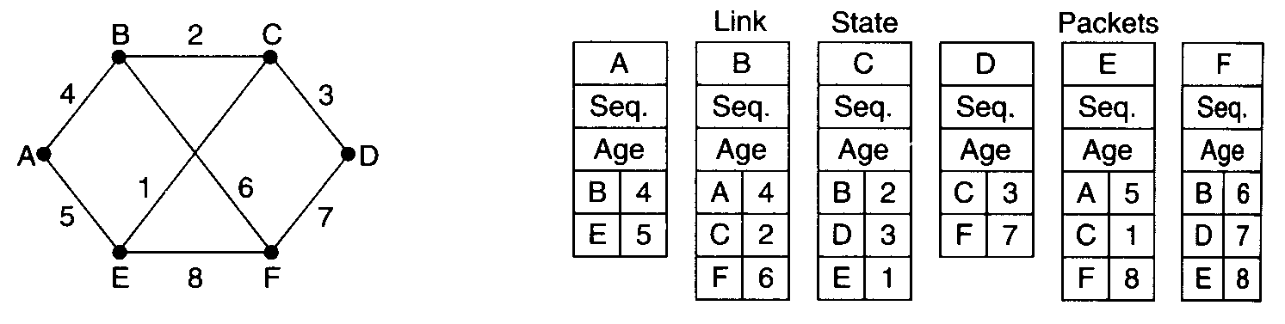
THE NETWORK LAYER
5.2 ROUTING ALGORITHMS - adaptive
Link State Routing (Second Generation in ARPANET) - the first generation did not consider the speed, but only the queue length, and took too long to converge.
1. Discover its neighbors and learn their network addresses.
2. Measure the delay or cost to each of its neighbors (e.g. by ECHO packets)
→ measure RTT/2 and calculate only the queue delay (to avoid load oscillation) or both, the queue delay and the communication load transformed to "link utilization".
3. Construct a packet telling all it has just learned, and send the packet to all routers.
4. Compute the shortest path to every other router.
→ The complete topology and all delays are experimentally measured and distributed to every router.
Stainov - DataCom
MET CS TC535

Slide 12
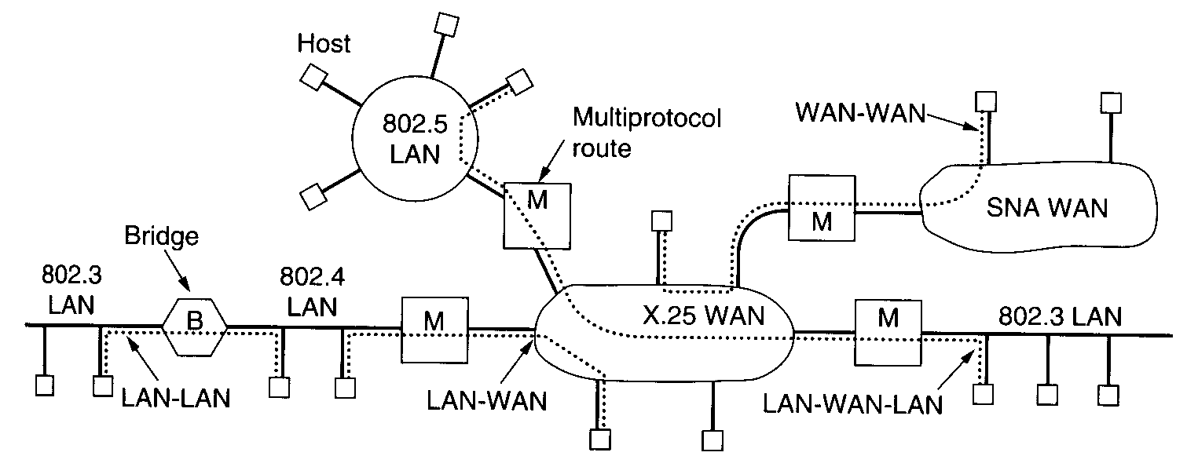
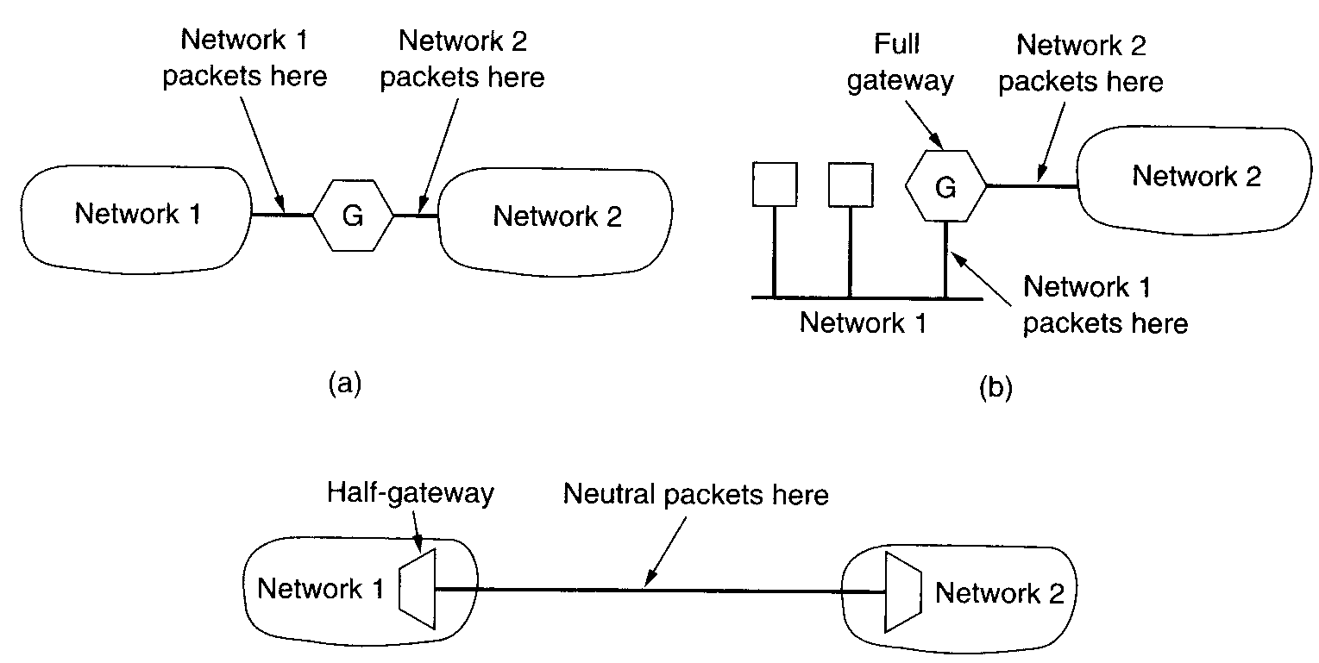
THE NETWORK LAYER
5.4 INTERNETWORKING
Repeater, Bridge, Muliprotocol Router, Transport Gateways, Application Gateways
Stainov - DataCom
MET CS TC535

Slide 13
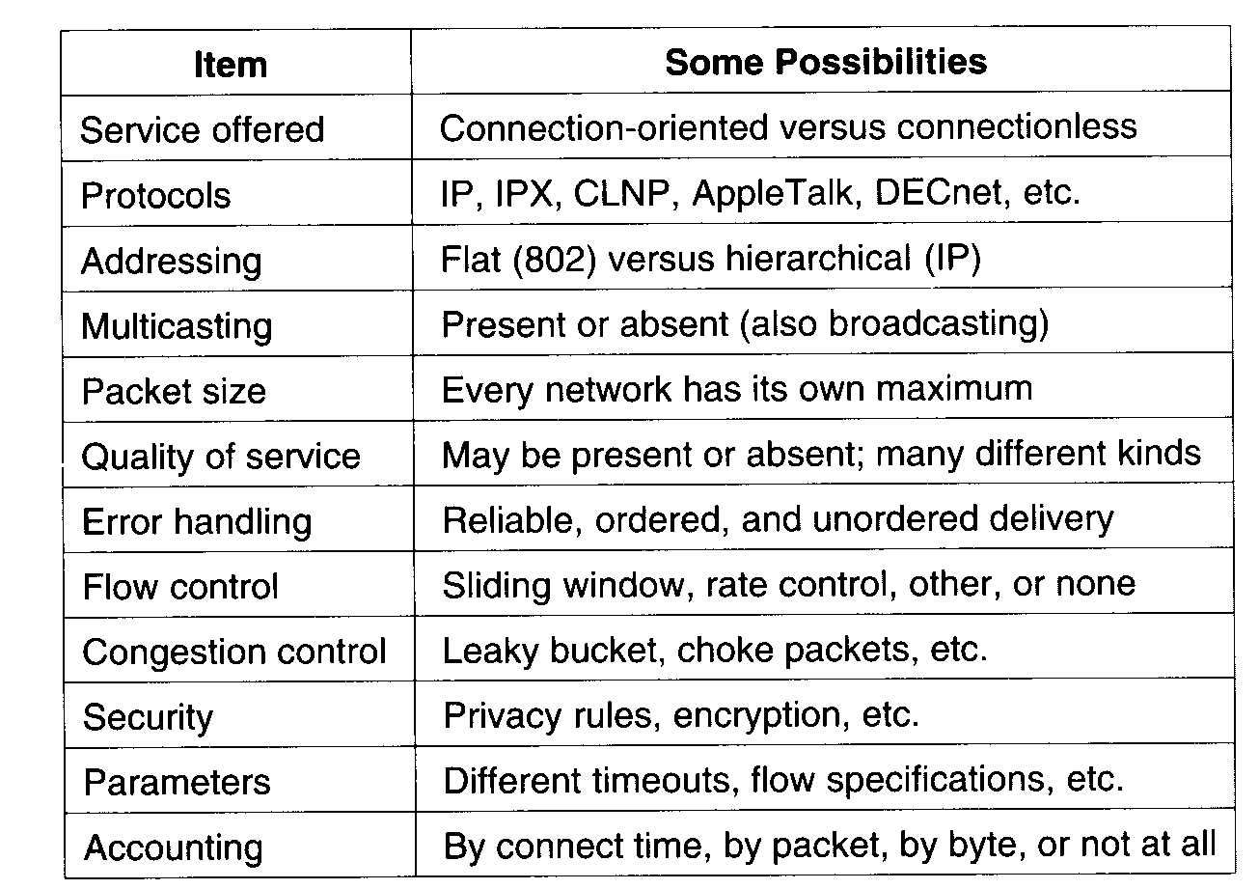
THE NETWORK LAYER
5.4 INTERNETWORKING
How networks differ?
Stainov - DataCom
MET CS TC535

Slide 14
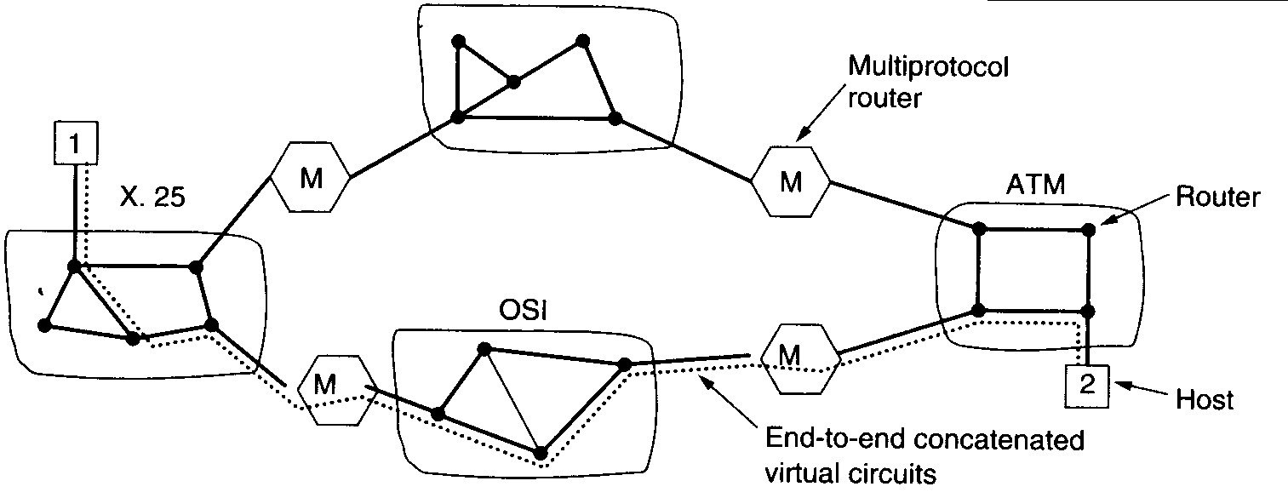
THE NETWORK LAYER
5.4 INTERNETWORKING
Concatenated Virtual Circuits
Stainov - DataCom
MET CS TC535

Slide 15
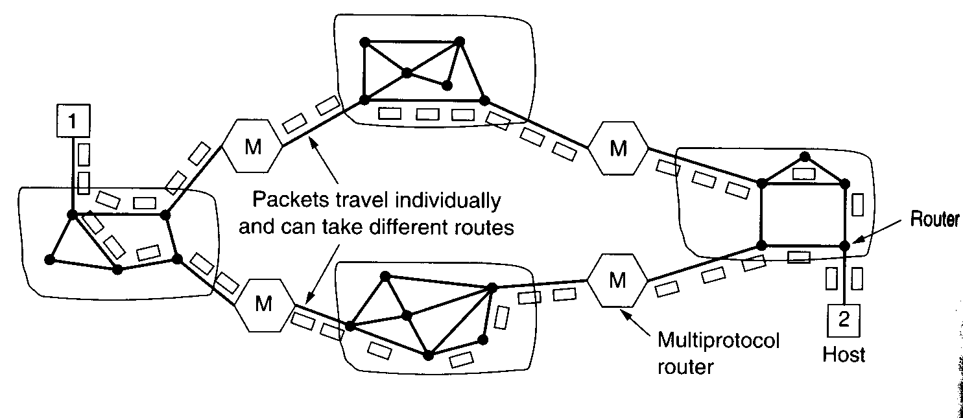
THE NETWORK LAYER
5.4 INTERNETWORKING
Connectionless Internetworking
Stainov - DataCom
MET CS TC535

Slide 16
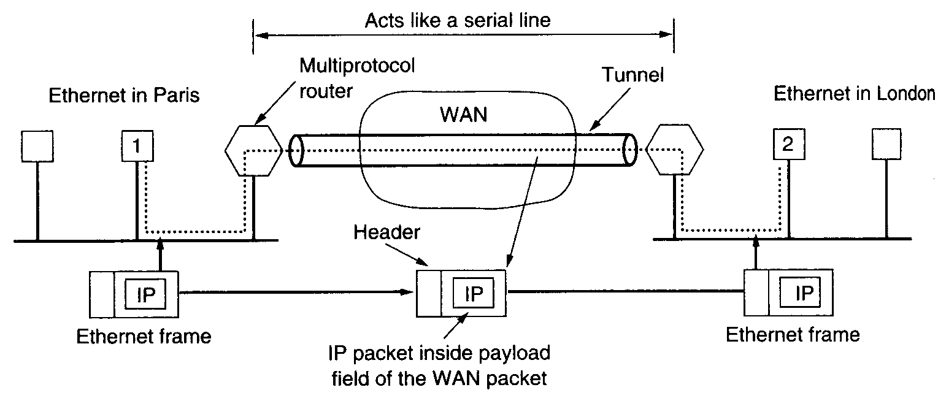
THE NETWORK LAYER
5.4 INTERNETWORKING
Tunneling
Stainov - DataCom
MET CS TC535

Slide 17
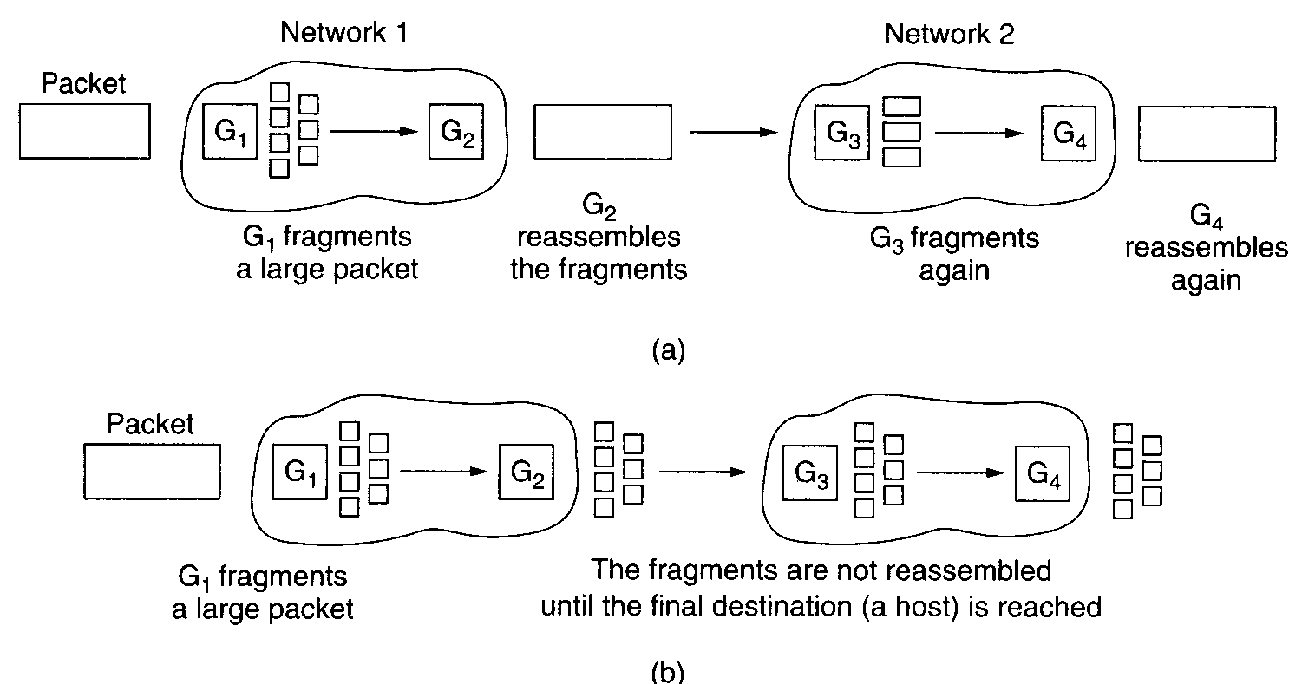
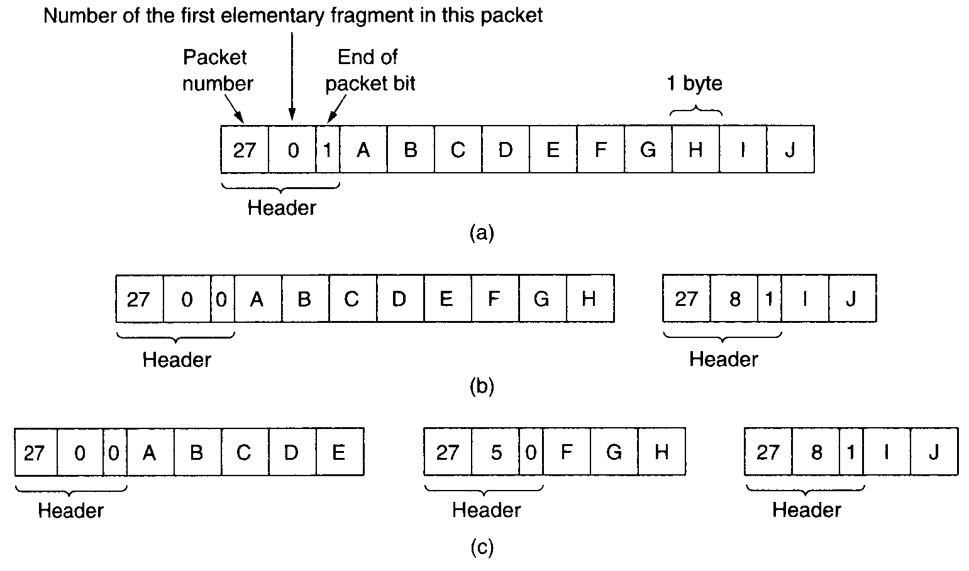
THE NETWORK LAYER
5.4 INTERNETWORKING
Fragmentation
See Applet
Stainov - DataCom
MET CS TC535

Slide 18
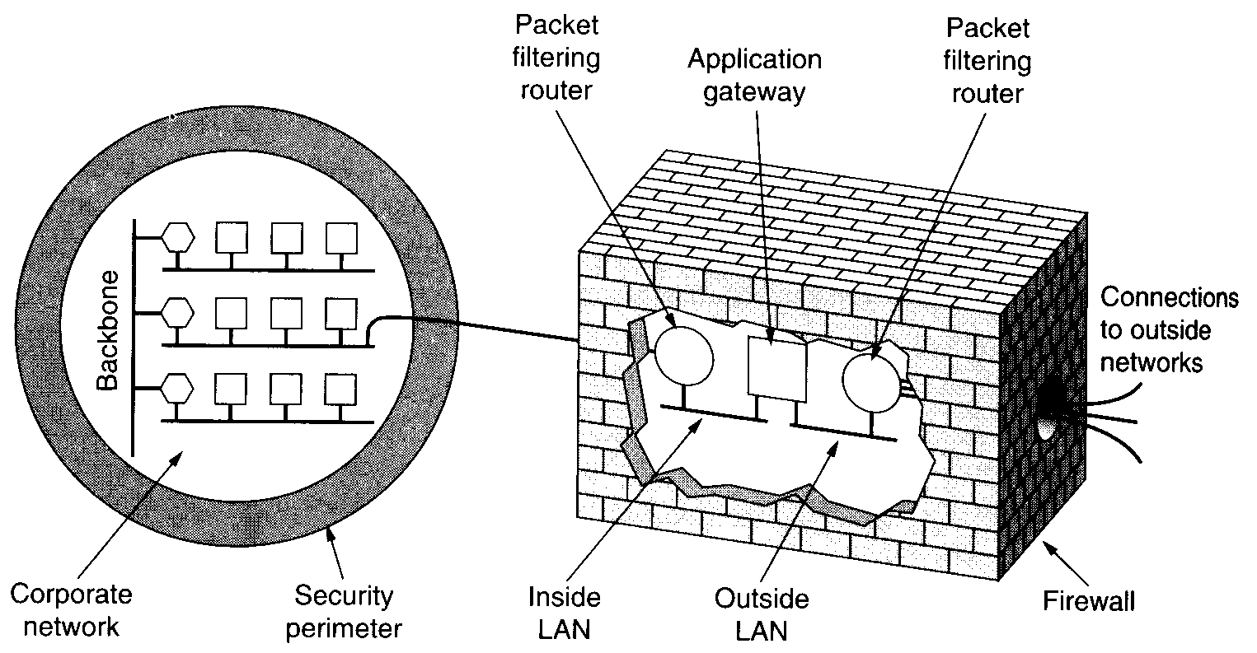
THE NETWORK LAYER
5.4 INTERNETWORKING - Firewalls
Stainov - DataCom
MET CS TC535

Slide 19
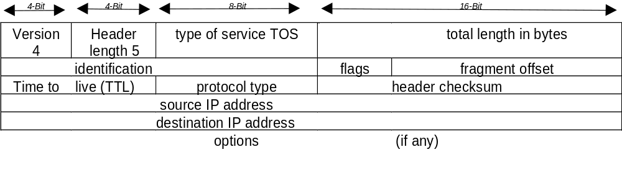
Internetworking
The Internet layer - the IP Protocol
The Type-Of-Service (TOS) is for a normal service 0.
The total length in bytes can be maximal 65535 bytes.
The identification uniquely identifies each datagram (incremented by the sender). It is used with flags and fragment offset for fragmentation and reassembly.
The TTL (Time-To-Live) sets a upper limit on the number of hops (rourters).
The protocol type is UDP, TCP, but also ICMP and IGMP.
The header checksum is calculated over the IP header only.
Stainov - DataCom
MET CS TC535

Slide 20
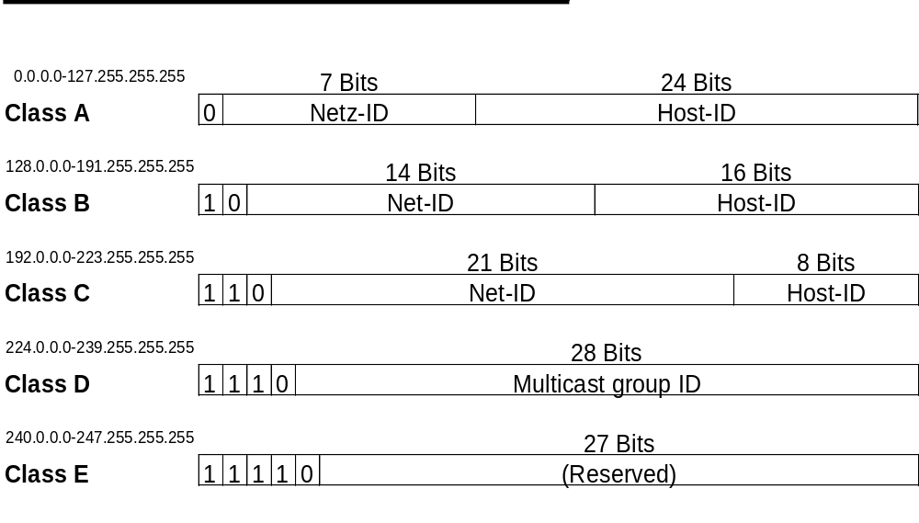
Internetworking
IP addresses
Stainov - DataCom
MET CS TC535

Slide 21
5.5 INTERNET: Subnets
a. The classic (and externally transparent) IP address:
b. Internal structuring of the IP address:
For example are the first 8 bits (= 1 byte) the host ID. The 3 high order bits can be used as subnet ID. It means, 2⁸ = 256 host addresses are divided into 2³ = 8 subnets with 2⁵ = 32 host addresses each.
How many bits are to be used for the subnet ID is specified by the subnet mask.
Example: The subnet mask 255.255.255.224, of a C class address means, that the three high order bits in the first byte are used for subnet IDs:
        11111111₂ . 11111111₂ . 11111111₂ . 11100000₂
Net-ID
Subnet-ID
Host-ID
Net-ID
Host-ID
Stainov - DataCom
MET CS TC535

Slide 22
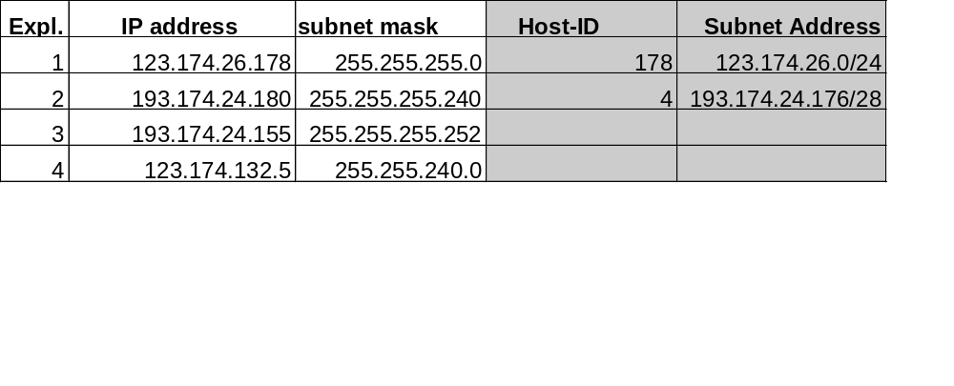
Internetworking
IP Subnets Example
11110000 = 240 (Mask)
10110100 = 180 (Host)
10110000 = 176 (Subnet)
11111100 = 252 (Mask)
10011011 = 155 (Host)
10011000 = 152 (Subnet)
Stainov - DataCom
MET CS TC535

Slide 23
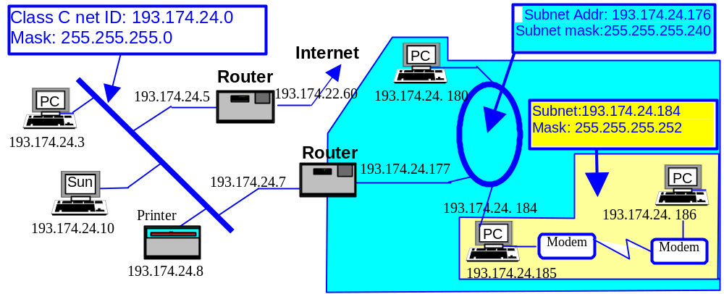
Internetworking
IP Subnets - Example
Stainov - DataCom
MET CS TC535

Slide 24
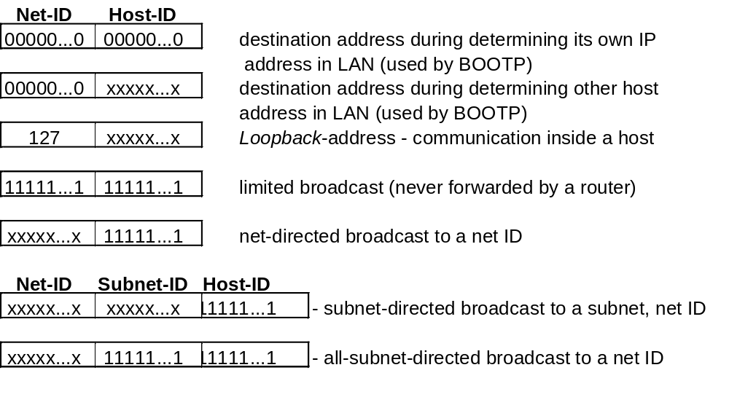
Internetworking
Stainov - DataCom
MET CS TC535

Slide 25
5.5 INTERNET: ARP
The Address Resolution Protocol (Mapping of IP into MAC addresses)
Every Ethernet board has a 48-bit Ethernet address
Algorithm:
If destination 128.197.102.51 is link-local
then broadcast “who has 128.197.102.51”
get his MAC address
cache the MAC address into the ARP table
Hint: Even Windows maintains an APR table → go to Command Prompt and start:
C:\WINNT\Profiles\rstainov\Desktop>arp -a
Interface: 128.197.101.75 on Interface 2
Internet Address Physical Address Type
128.197.101.32 00-90-27-9a-a4-f7 dynamic
Stainov - DataCom
MET CS TC535

Slide 26
5.5 INTERNET
IP-Routing Principle:
If destination address local, then deliver datagram,
else forward datagram to default-Router
Basis: Routing table of the IP layer; each entry contains:
• destination address: network or host address (specified by the flag G or H)
• IP address of the next-hop router (Flag G) or address of directly connected network
• flags for the route (if set): G - routing to a gateway (not to an interface), H - the destination is a host address (not a network address), D - created by redirect, M - modified by redirect, U - route is up.
Specification of the network interfaces to be used for transmission (ARP is used).
Stainov - DataCom
MET CS TC535

Slide 27
Internetworking
Hosts and routers
Hosts (end systems) typically perform no routing
start packets on their way
send packets to nearest (default) router
Q: how do hosts learn identity of nearby router:
A1: IP address of router hard-coded into file (see /etc/networks on many UNIX systems)
A2: router discovery: RFC 1256
router periodically broadcasts its existence to attached hosts
host (on startup) broadcasts query (who is my router) on attached links/LANs
Stainov - DataCom
MET CS TC535

Slide 28
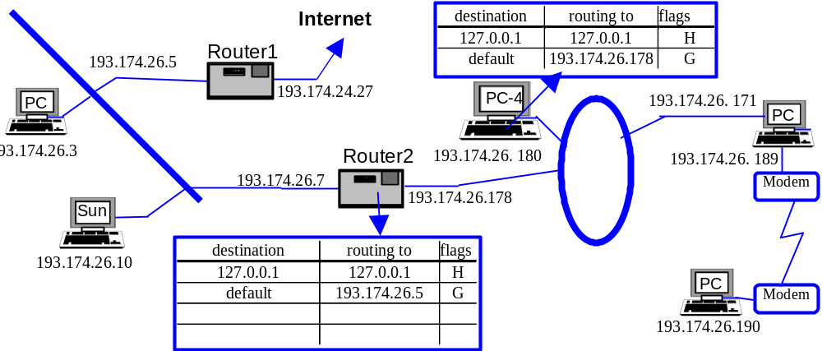
Internetworking
IP Routing Example
Stainov - DataCom
MET CS TC535

Slide 29
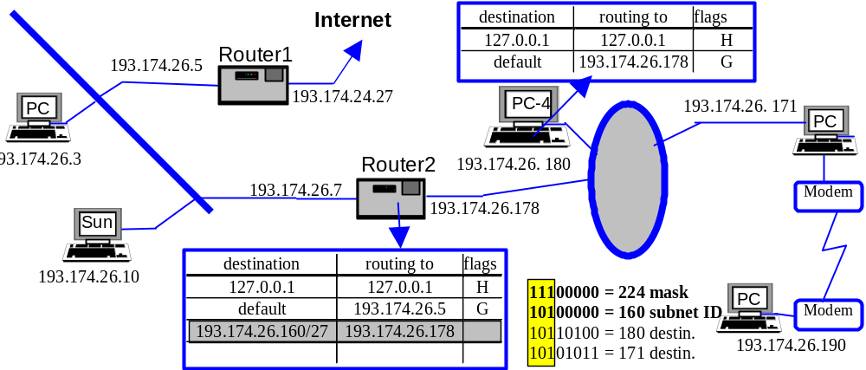
Internetworking
IP Routing Example
Stainov - DataCom
MET CS TC535

Slide 30
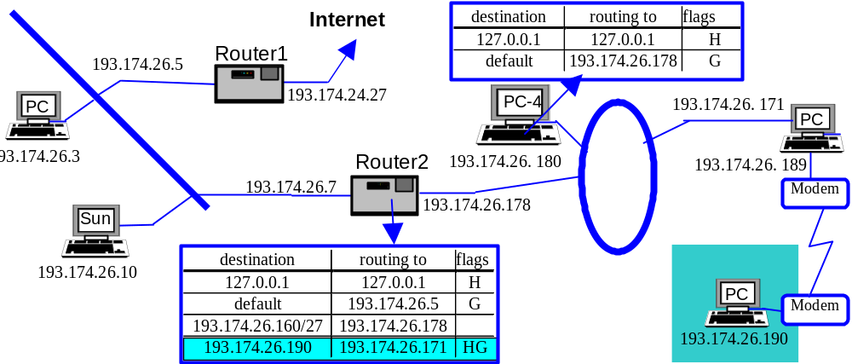
Internetworking
IP Routing Example
Stainov - DataCom
MET CS TC535

Slide 31
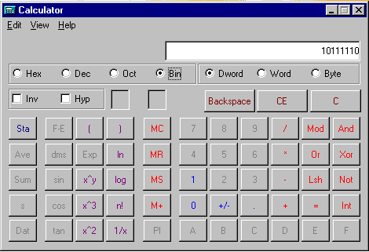
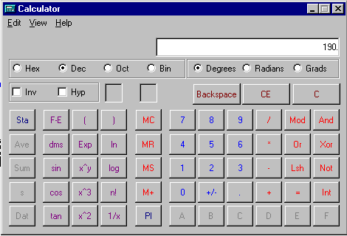
Internetworking
Using the Windows Calculator to convert between binary and decimal
Stainov - DataCom
MET CS TC535

Slide 32
Internetworking
Practical exercise: Even Windows maintains a routing table
→ go to Command Prompt and start:
C:\WINNT\Profiles\rstainov\Desktop>route Print
==========================================================================
Interface List
0x1 ........................... MS TCP Loopback interface
0x2 ...00 01 02 35 5e fa ...... 3Com EtherLink PCI
==========================================================================
Active Routes:
Network Destination Netmask Gateway Interface Metric
0.0.0.0 0.0.0.0 128.197.101.1 128.197.101.75 1
127.0.0.0 255.0.0.0 127.0.0.1 127.0.0.1 1
128.197.101.0 255.255.255.0 128.197.101.75 128.197.101.75 1
128.197.101.75 255.255.255.255 127.0.0.1 127.0.0.1 1
128.197.255.255 255.255.255.255 128.197.101.75 128.197.101.75 1
224.0.0.0 224.0.0.0 128.197.101.75 128.197.101.75 1
255.255.255.255 255.255.255.255 128.197.101.75 128.197.101.75 1
===========================================================================
Stainov - DataCom
MET CS TC535

Slide 33
Internetworking
Hierarchical Routing
problem: as size of network grows, routing table, complexity grows
    millions of nodes (hosts, routers) in Internet
solution: hierarchically aggregate nodes into "regions" (domains)
    node have full knowledge of routes, topological structure within region
    one (or more) nodes in region responsible for routing to the outside
Stainov - DataCom
MET CS TC535

Slide 34
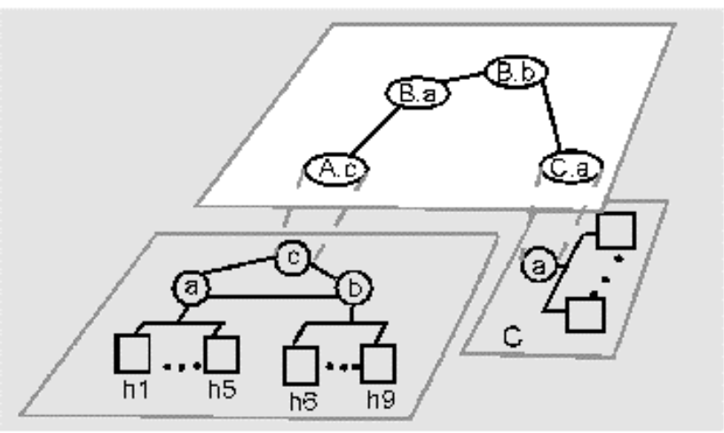
Internetworking
Hierarchical Routing
three domains: A, B, C
A.a, A.b A.c run interdomain routing protocol (BGP)
A.c, B.a, B.b, C.a run intradomain routing protocol among themselves (OSPF)
intradomain routing: within domain
interdomain routing: between domains
Stainov - DataCom
MET CS TC535

Slide 35
Internetworking
  Interior Gateway Routing Protocol (Open Shortest Path First)
OSPF for intradomain routing within an autonomous system (AS)
1. Uses link state algorithm to determine routes
each outgoing link (interface) assigned dimensionless cost
load balancing: with several equal-cost-paths to destination, will distribute load across both paths
2. Adding some security
3. Support for routers connected to a tunnel, over LAN, WAN, and point-to-point lines
Stainov - DataCom
MET CS TC535

Slide 36
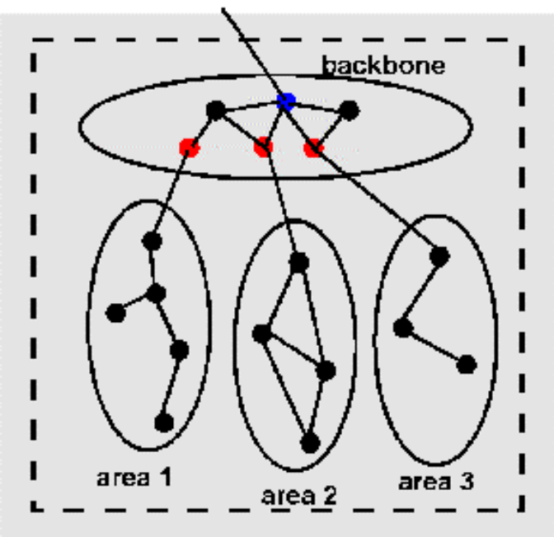
Internetworking - OSPF
4. Support for hierarchy:
autonomous system (connected by homogeneous routers) divided into "areas"
one area designated "backbone"
area border routers in backbone route between areas
other routers in backbone also
AS boundary router talks to outside world
area routers: red
boundary router: blue
intra-area routing:
source area -> backbone -> destination area
Stainov - DataCom
MET CS TC535

Slide 37
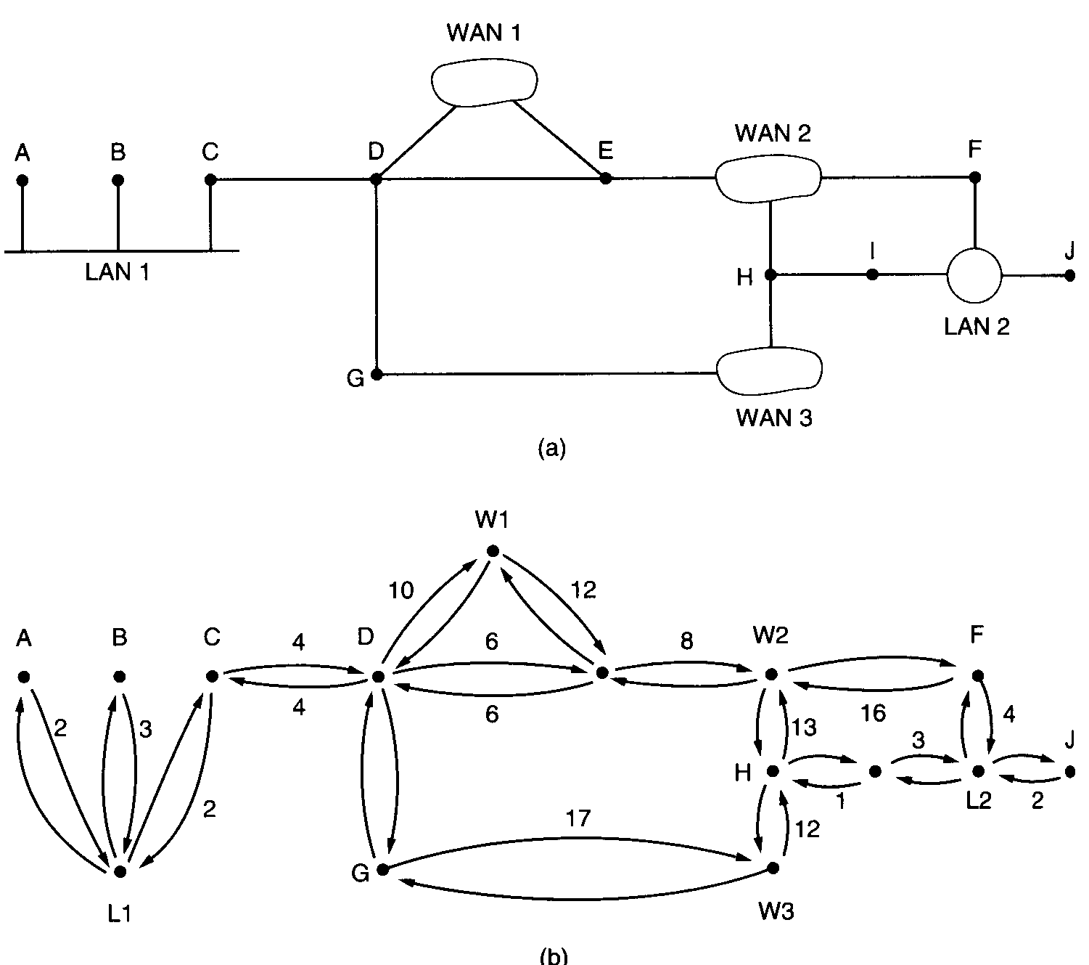
5.5 INTERNET: OSPF
5. Abstracts the collection of actual networks, routers, and lines into a directed graph in which each arc is assigned a cost (distance), and then computes the shortest path (avoids Count-to-Infinity Problem).
Stainov - DataCom
MET CS TC535

Slide 38
Internetworking
Interdomain Internet Routing: BGP (Border Gateway Protocol RFC 1267, 1268)
routing between nodes in different autonomous systems
(i.e., routing between networks, exterior router protocol)
uses a distance verctor approach
Policy-Based Routing
rather than costs to destinations, BGP routers exchange full path information (networks crossed) to destination
router can decide on policy basis which route to take
e.g. "traffic from my AS should not cross AS's a,b,c,d"
BGP implementation
Implemented as a daemon (user-level process)
communicates with other BGP routers using TCP
Stainov - DataCom
MET CS TC535

Slide 39
Internetworking
Practical exercise: Even Windows allows to trace a routing path
→ go to Command Prompt and start:
C:\WINNT\Profiles\rstainov\Desktop>tracert www.mit.edu
Tracing route to DANDELION-PATCH.MIT.EDU [18.181.0.31]
over a maximum of 30 hops:
1 <10 ms 10 ms <10 ms COMM808-0201NET-GW.BU.EDU [128.197.101.1]
2 <10 ms <10 ms <10 ms buic025-bbonenet-gw.bu.edu [128.197.5.57]
3 <10 ms <10 ms <10 ms crc-ext-gw.bu.edu [128.197.254.60]
4 <10 ms <10 ms <10 ms 192.5.89.13
5 <10 ms <10 ms <10 ms 192.5.89.10
6 <10 ms <10 ms <10 ms NW12-RTR-FDDI.MIT.EDU [18.168.0.16]
7 <10 ms <10 ms <10 ms DANDELION-PATCH.MIT.EDU [18.181.0.31]
Trace complete.
Stainov - DataCom
MET CS TC535

Slide 40
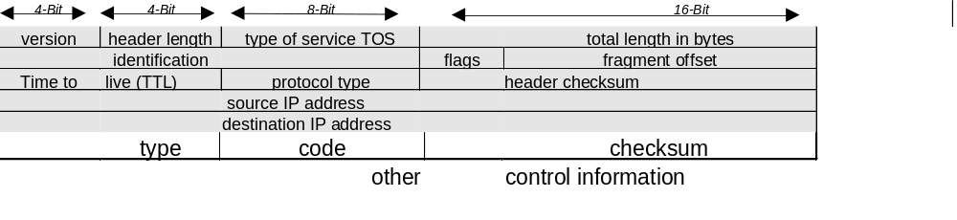
Internetworking
  ICMP
Stainov - DataCom
MET CS TC535

Slide 41
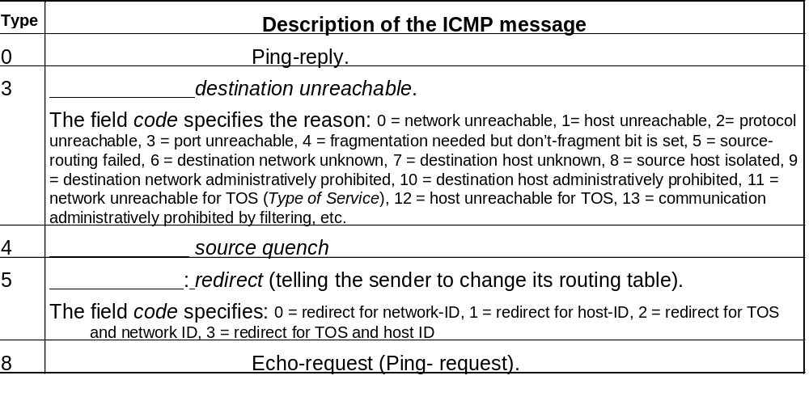
Internetworking
  ICMP
Stainov - DataCom
MET CS TC535

Slide 42
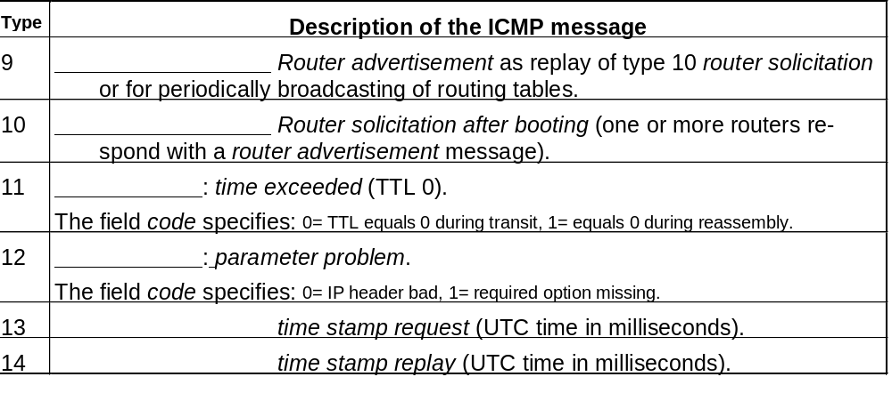
Internetworking - ICMP
  ICMP
Stainov - DataCom
MET CS TC535

